Slide 1
OSC Layout Update and Considerations 11/20/2018

Slide 2
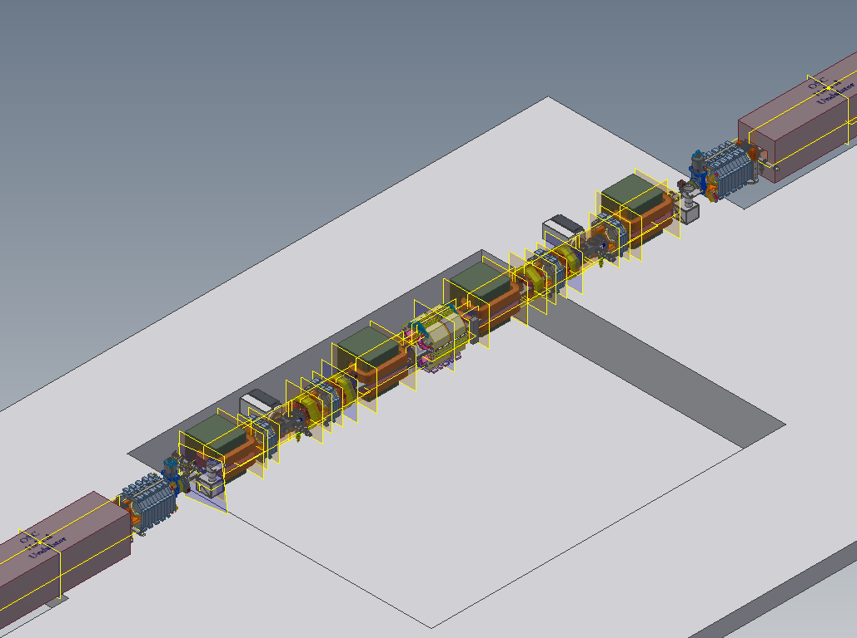

Slide 3
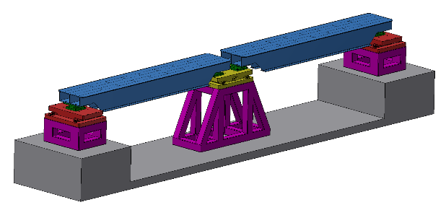
Phase 1 Summer 2018
Phase 2 Summer 2019?
Core items:
Complete vacuum system with placeholder beam pipes
Motion system that will support all magnets and OSC equipment in the bypass
Stands/supports for beam pipes
BPMs
New synch light optics chambers
Extra wide window frame horizontal steering
Modify existing CESR soft bends to add a viewport?
Coordinate with Rich Gallagher to schedule removal of existing L3 equipment
Redesigned/cheaper
rails or motion system

Slide 4
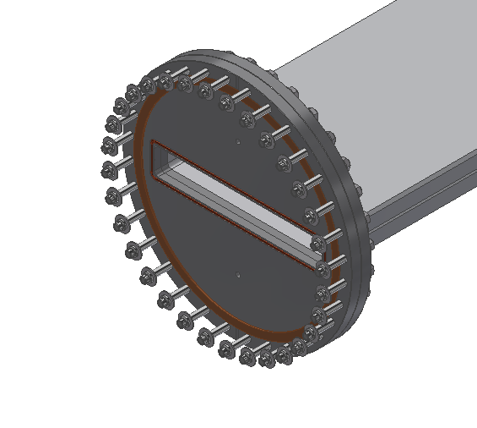
14 cm length
Reserved for filter
12 button BPM
CHESS RF Flanges
Bal Seal
0.82m
Extra wide
window frame
horizontal steering

Slide 5
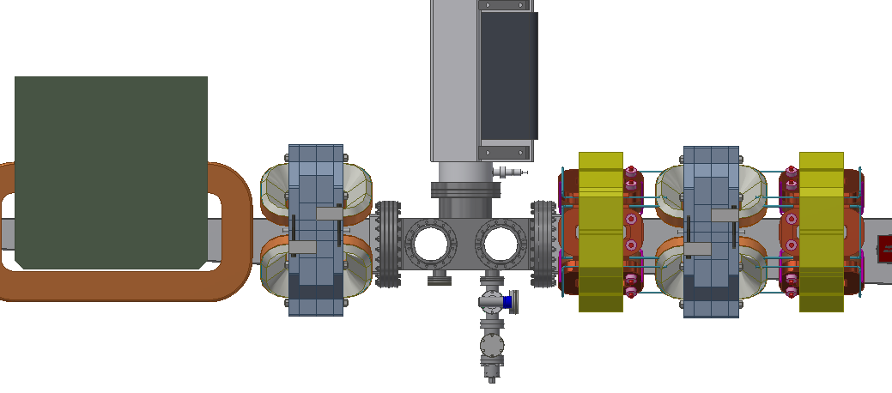
Re-use existing
2x 270L ion pumps
OSC optics chamber
Usable inside length: 38 cm
32.5cm
24.5cm

Slide 6
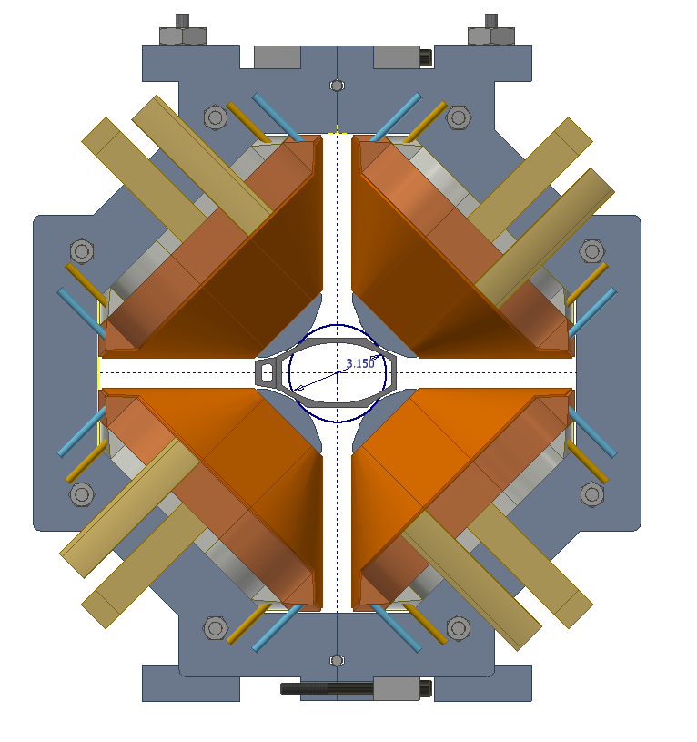
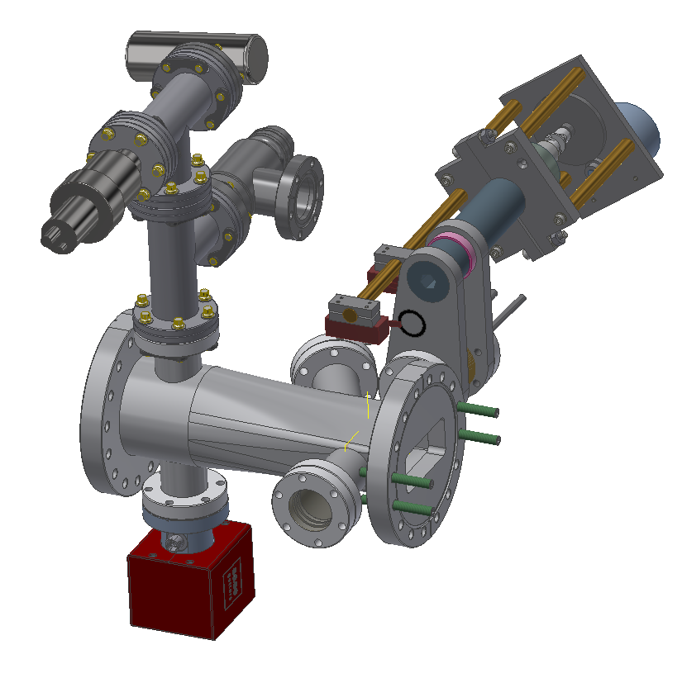
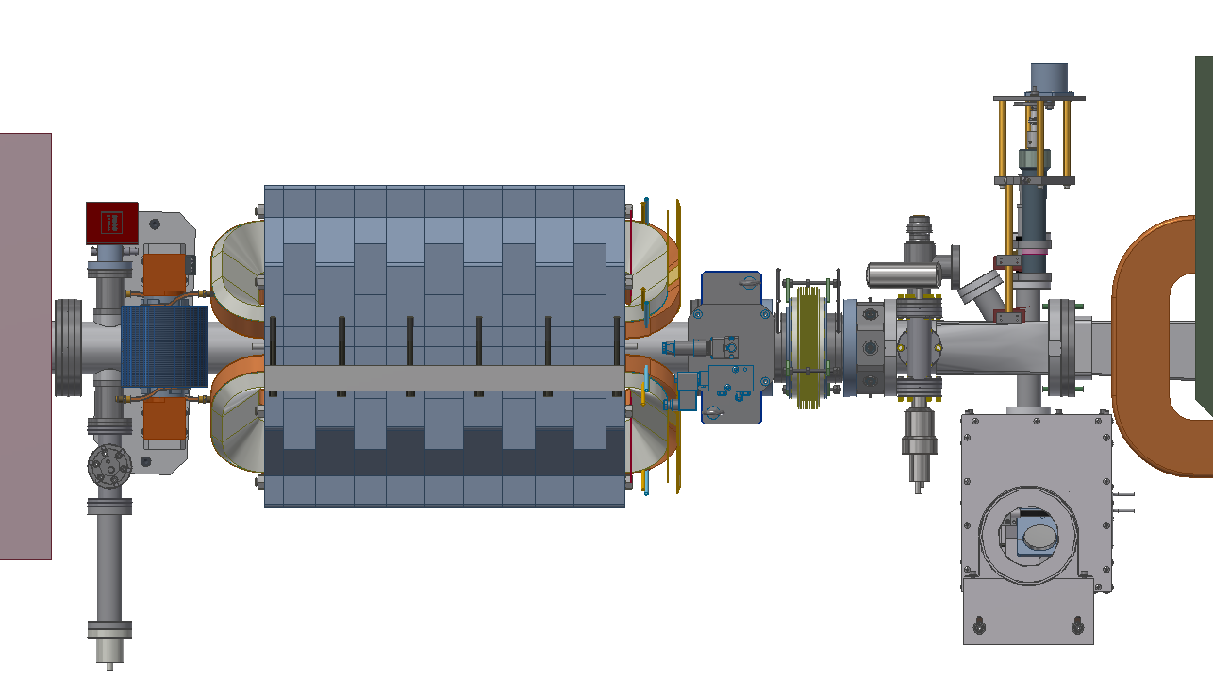
Redesigned synch light optics chambers
Cramped, but should have a vacuum joint here
CESR MKII:
Max 80mm OD
Beam pipe

Slide 7
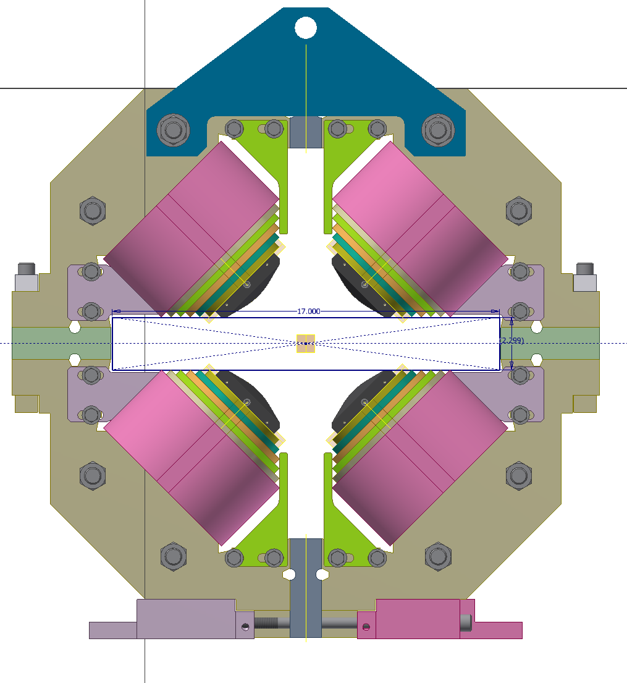
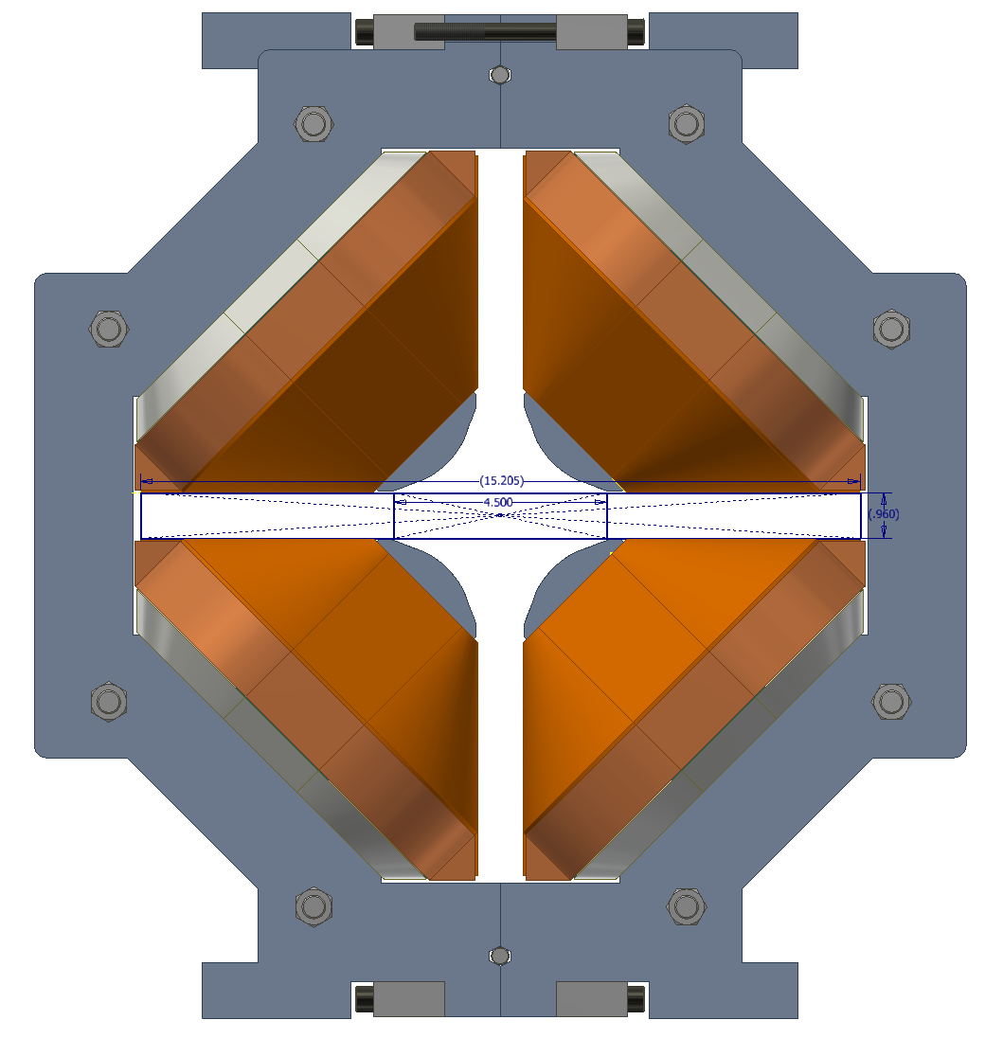
Center Quad Q49
20 cm OSC Quads
386 mm
432 mm
23 mm
58 mm

Slide 8
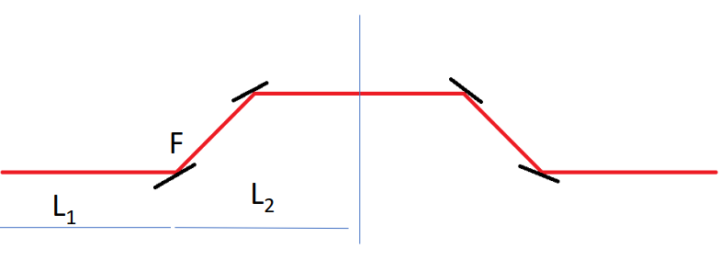
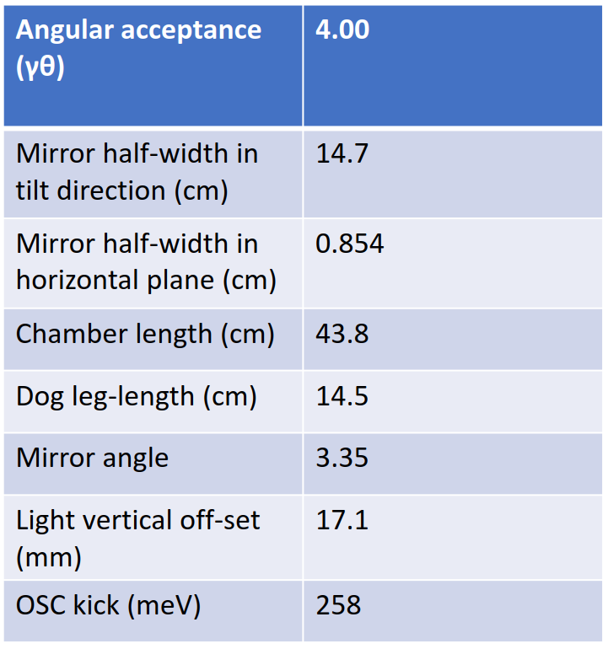
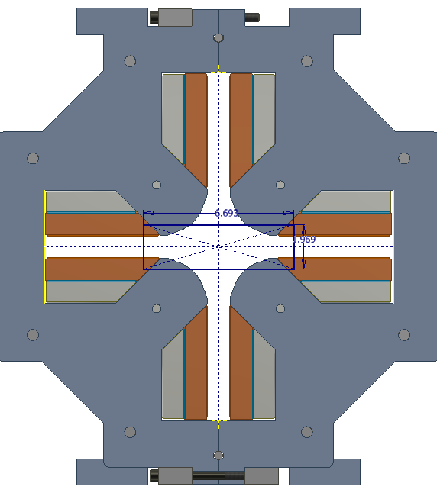
Vacuum chamber aperture considerations for OSC Bypass Optics
24.5 mm height
71 mm width
CHESS-U rev5.6.4 Latest OSC lattice 1% emittance coupling
Side view inside vacuum chamber
?
~5
24.5
What is an appropriate OSC chamber inner height and what should we do about the CESR MKII laminations?
Inner quads:
17 cm x 50mm
beam pipe

Slide 9
Vacuum chamber considerations for OSC Bypass Optics
~15% drop in yield strength after aging during bake out
TO DO:
Simulate and detail design vacuum chambers
Update and check vacuum quality with proposed system and final inner dimensions
Verify clearances for quadrupole and bend magnet coils w.r.t. flange bolt pass-throughs
Figure 18. Ageing data for alloy 6061 for reheating from the T6 condition for 10 temperatures. Samaras 2006

